Slide 1
Chatbot Data Analysis Using Tableau
Name: Chinmay Pradhan
Roll no.: 31031520025
Semester IV Project

Slide 2
Introduction
Chatbots are the most important but still evolving feature for a website. This technology is also getting integrated with new generation hardware devices to improve autonomous tasks and reduce human effort.
The integration of a chatbot with current other applications is possible because of recent research on “human parity level speech detection” and smarter sentiment analysis.
There are many open-source and paid systems available in the market, some of the open-source systems are Microsoft Bot Framework, Rasa, and some of the paid systems are IBM Watson, Amazon Lex and many more.

Slide 3
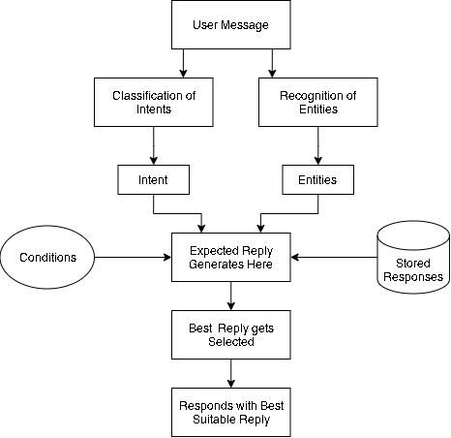
Functioning of Chatbot
Intent: used to understand user’s intention
Entity: Used to modify an intent
Response generator: The response generator in the Chatbot do the calculations using different algorithms to process the user request
Response Selector: used to select the word or text according to the user queries

Slide 4
Implementation Details
Steps to create Chatbot in Flask
Import and load the data file
Preprocess data
Split the data into training and test
Build the model using keras
Predict the outcomes
Deploy the model in the Flask app
Libraries used
Nltk
Numpy
Json
Pickle
keras.models import Sequential
Flask

Slide 5
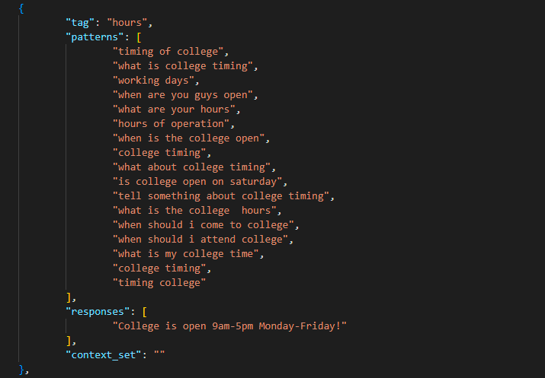
Experimental set up and results
The data file is in JSON format so we used the json package to parse the JSON file into Python.

Slide 6

Analysis of the results
After training the model for 300 epochs, we achieved 98% accuracy on our model. Then we will save it in a model as ‘model.h5’.

Slide 7
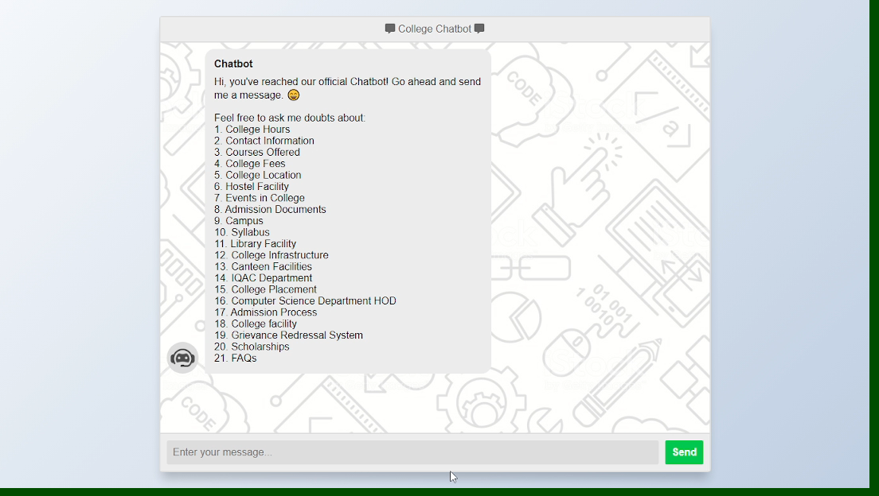
Output when chatbot deployed on Flask

Slide 8
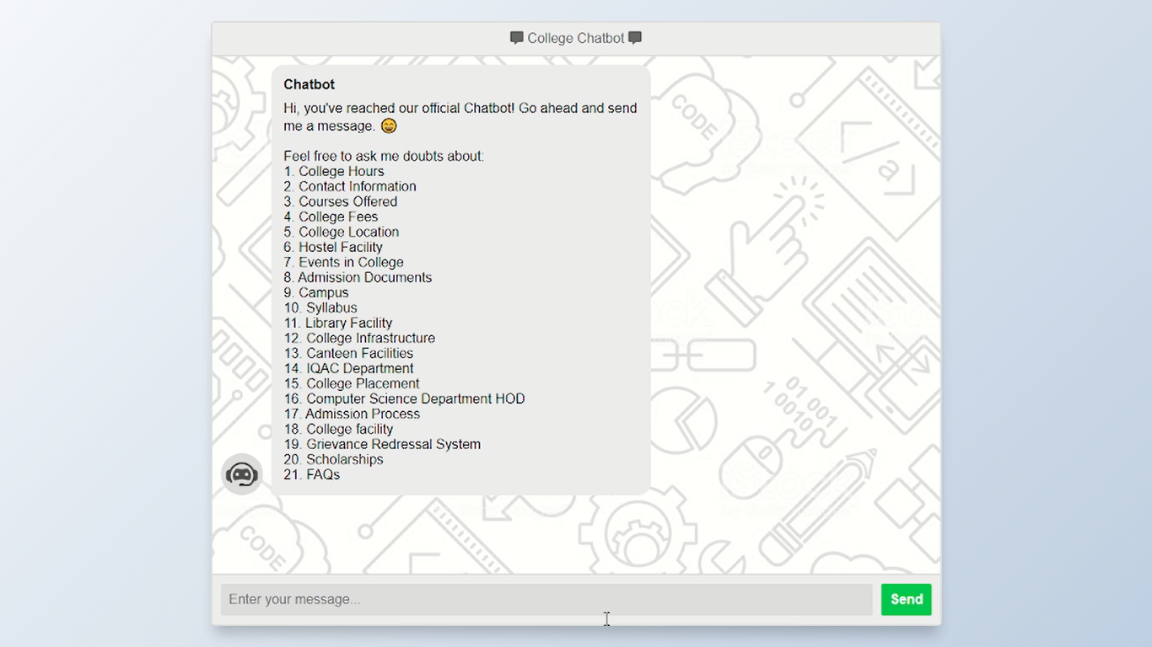
Analysis of the results
With the help of interface the user can chat with chatbot and
take the required information as an output.

Slide 9
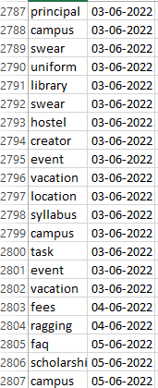
Analysis of the results
Now, when the session is ongoing, with the help of algorithm the chatbot sends the ‘tags’ which is assigned in a json file to the csv file with date in the real time

Slide 10
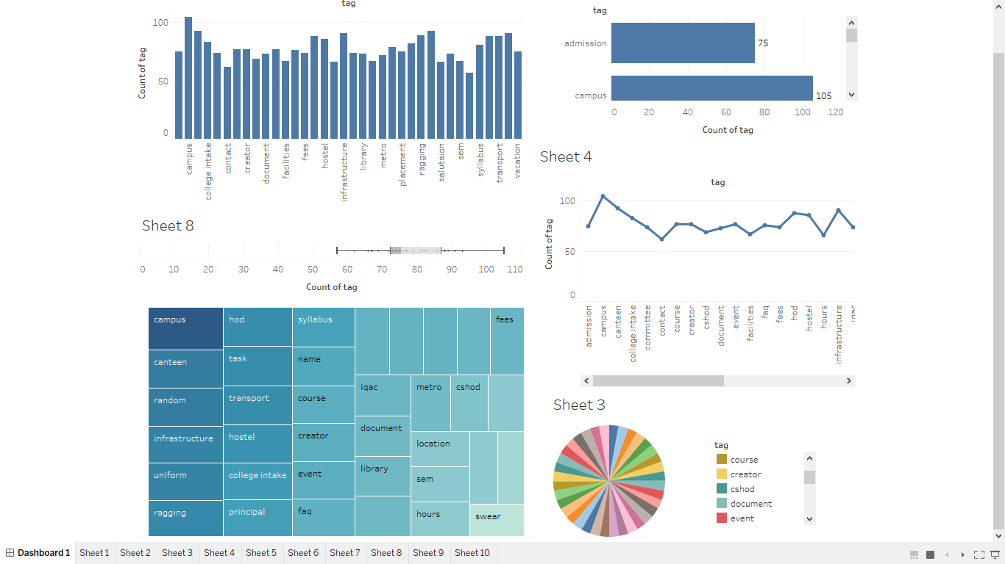
Analysis of the results - Dashboard

Slide 11
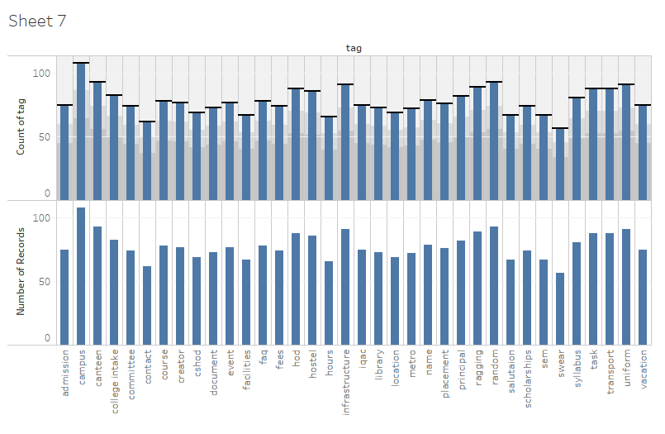
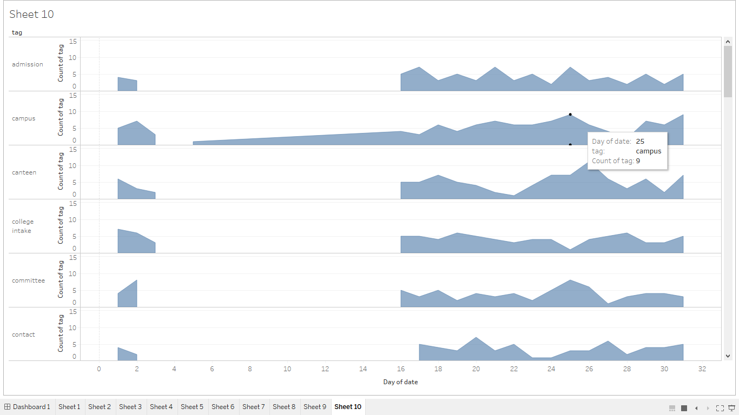
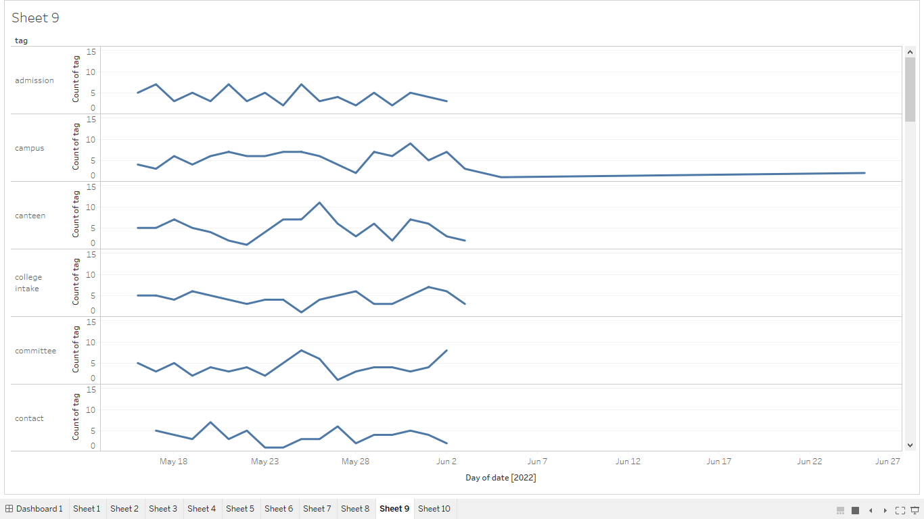
Analysis of the results

Slide 12
Conclusion
In this project, I presented the chatbot idea where in it can be implemented and derived in any professional sector.
The chatbot can be produced for any reason like educational use, shopping, client administrations, food request, news updates, reservation and substantially more. By utilizing the examination and results, anybody can choose or select the cloud stage to construct the chatbot.
While developing the system a conscious effort has been made to create and develop a software package, making use of available tools, techniques and resources – that would generate a proper system.
Moreover, while making the system, an eye has been kept on making it as user-friendly.

Slide 13
Future Enhancement
Speech recognition feature through which students can ask their queries verbally and get the answers from the bot.
Integration with multiple channels such as phone call, SMS, and various social media platforms like Skype, Facebook and Twitter.
Handling context aware and interactive queries in which chatbot will be aware of the context of an ongoing conversation with a student.
Integration with services such as password reset and course enrolment.
Adding a capability for the bot to perform analytics based on user’s sentiment based on which the bot can be re-trained on human emotions so that more empathy can be added to the bot.

Slide 14
Thank You!

